Slide 1
Outline
MOS Physics
nFET Current-Voltage Equations
The FET RC Model
pFET Characteristic
Modeling of Small MOSFETs

Slide 2
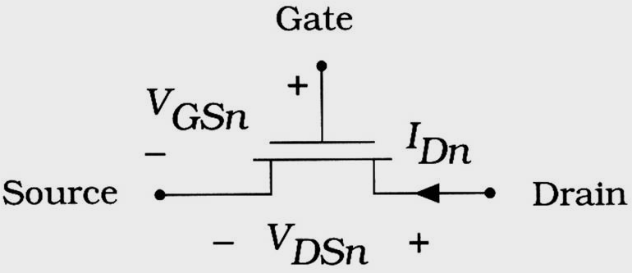
MOS Physics
MOSFETs conduct electrical current by using an applied voltage to move charge from the source to drain of the device
  Occur only if a conduction path, or channel, has been created
  The drain current I_{Dn} is controlled by voltages applied to the device
I_{Dn} = I_{Dn}(V_{GSn}, V_{DSn})
(6.1)
Figure 6.1 nFET current and voltages

Slide 3
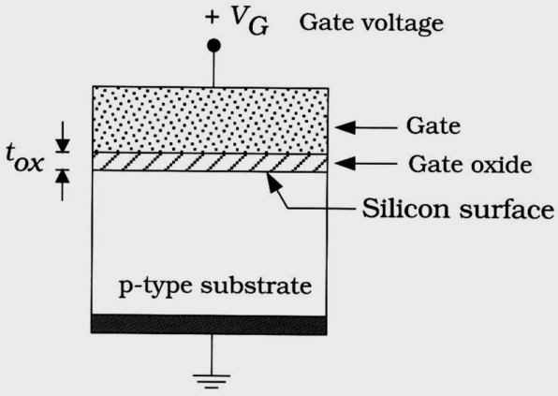
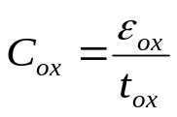

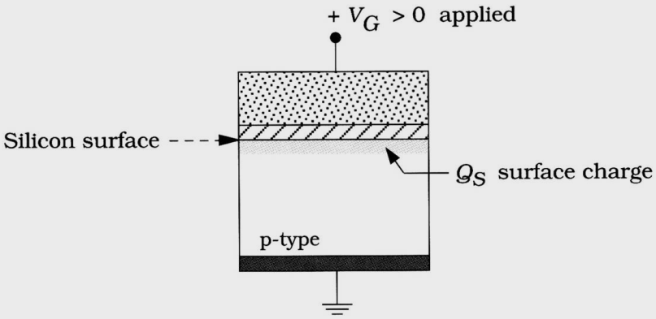

Field-effect
Simple MOS structure
  Silicon dioxide (S_{i}O₂) acts as an insulator between the gate and substrate
  C_{ox} determines the amount of electrical coupling that exists between the gate electrode and the p-type silicon region
  What is Field-effect ?
    The electric field induces charge in the semiconductor and allows us to control the current flow through the FET by varying the gate voltage V_{G}
(C/ cm²) (6.2)
Where, t_{ox} is the thickness of the oxide in cm
Figure 6.2 Structure of the MOS system
(6.3)
Figure 6.3 Surface charge density Q_{s}

Slide 4
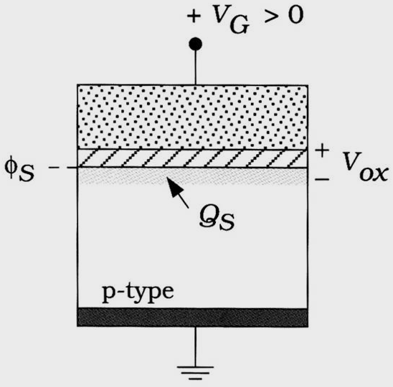


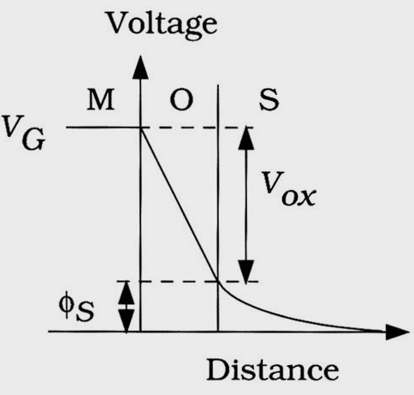
Threshold Voltage
At the circuit level, V_{th} is obtained by KVL
The oxide voltage V_{ox} is the difference (V_{G} - ) and is the result of a decreasing electric potential inside the oxide
(6.4)
Where, V_{ox} is the voltage drop across the oxide layer
and is the surface potential that represents the voltage at the top of the silicon
Figure 6.4 Voltages in the MOS system

Slide 5
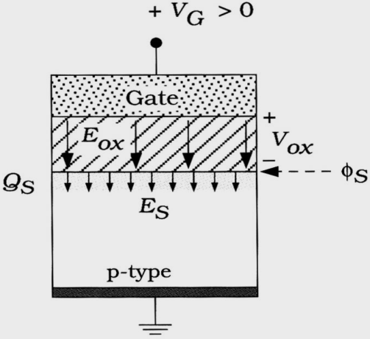




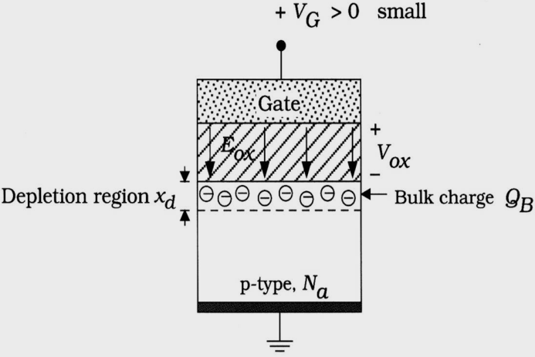


Electric Fields of MOS (1/2)
Lorentz law: an electric field exerts a force on a charged particle
A depleted MOS structure cannot support the flow of electrical current
(6.5)
(6.6)
(positively charged holes)
(6.7)
(negatively charged electrons)
Figure 6.5 MOS electric fields
(6.8)
(bulk charge)
Where
(6.9)
(the oxide voltage is related to the bulk charge)
Figure 6.6 Bulk (depletion) charge in the MOS system

Slide 6


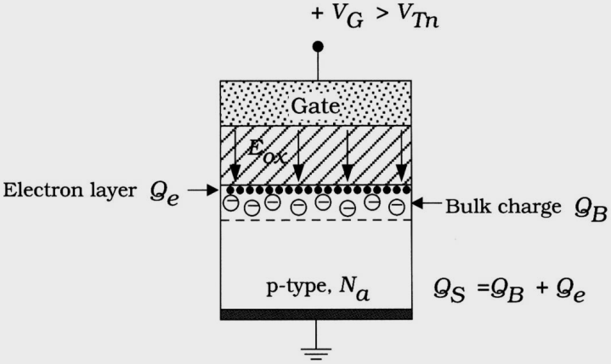

Electric Fields of MOS (2/2)
For V_{G} < V_{Tn}, the charge is immobile bulk charge and Q_{S} = Q_{B}
For V_{G} > V_{Tn}, the charge is mode up of two distinct components such that
If V_{G} = V_{Tn}, then Q_{e} = 0
If V_{G} > V_{Tn}, then
(6.10)
Where Q_{e}: electron charge layer that electrons are mobile and can move in a lateral direction (parallel to the surface, also called a channel region)
(6.11)
Figure 6.7 Formation of the electron charge layer

Slide 7
Outline
MOS Physics
nFET Current-Voltage Equations
The FET RC Model
pFET Characteristic
Modeling of Small MOSFETs

Slide 8
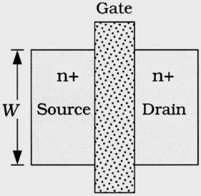
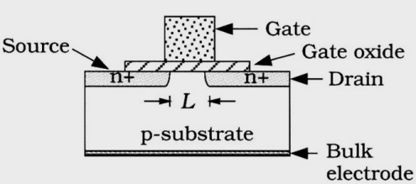


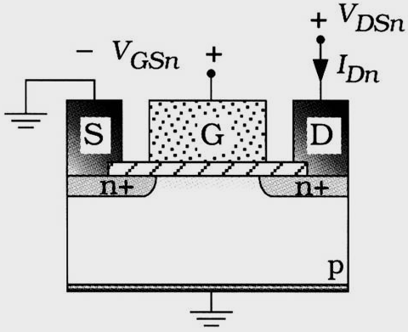
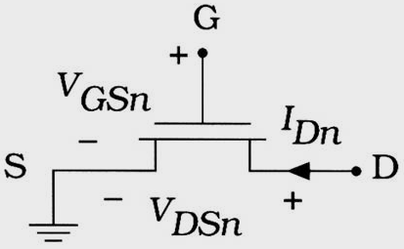
nFET
The dimensionless quantity (W/L) is the aspect ratio that is used to specify the relative size of a transistor with respect to others
The MOS structure allows one to control the creation of the electron charge layer Q_{e} under the gate oxide by using the gate-source voltage V_{GSn}
(a) Side view
(b) Top view
(6.19)
Figure 6.8 Details of the nFET structure
(a) Symbol
(b) Structure
Figure 6.9 Current and voltages for an nFET

Slide 9
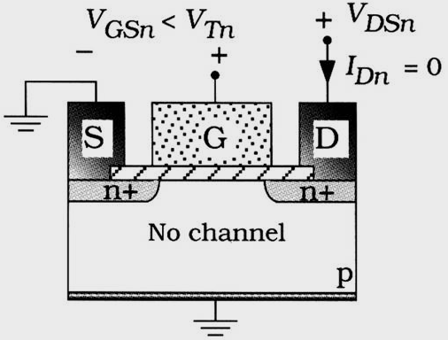
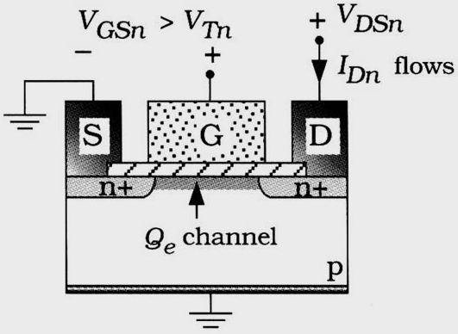
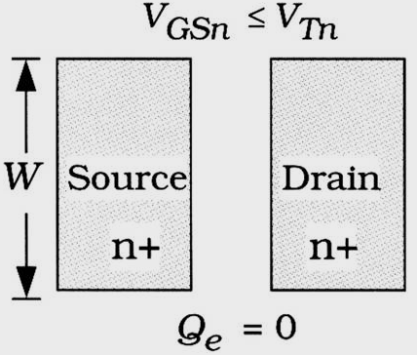
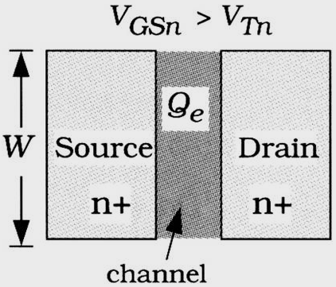
Channel Formation for nFET
Cutoff mode as Figure 6.10 (a)
  If V_{GSn} < V_{Tn}, then Q_{e} = 0 and I_{Dn} = 0
  Like an open switch
Active mode as Figure 6.10 (b)
  If V_{GSn} > V_{Tn}, then Q_{e} ≠ 0 and I_{Dn} = F(V_{GSn}, V_{DSn})
  Like an closed switch
(a) Cutoff
(b) Active bias
Figure 6.10 Controlling the channel in an nFET
(a) Cutoff
(b) Active
Figure 6.11 Channel formation in an nFET

Slide 10
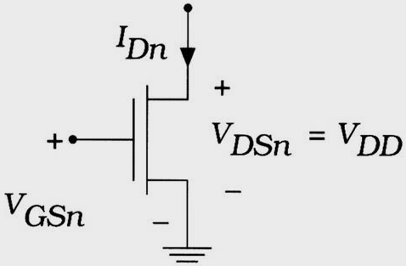




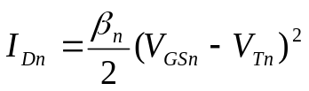
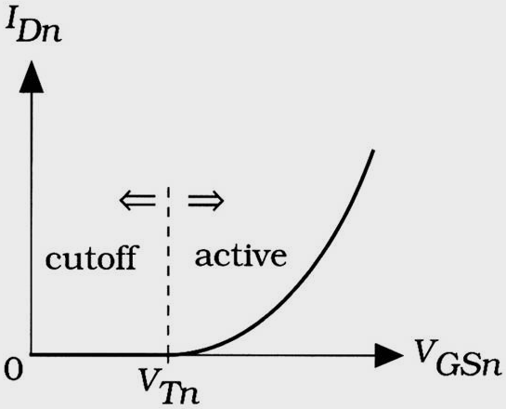
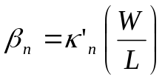

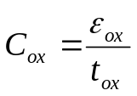
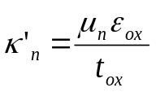
nMOS I–V Characteristics (1/2)
Three region for nMOS
According Figure 6.12 (Model I, V_{DSn} = V_{DD})
(6.20)
(saturation current)
(6.21)
(β_{n}: device transconductance parameter)
(A/V²)
(6.22)
(k’_{n}: process transconductance parameter)
(6.23)
Figure 6.12 I-V characteristics as a function of V_{GSn}
(6.24)

Slide 11
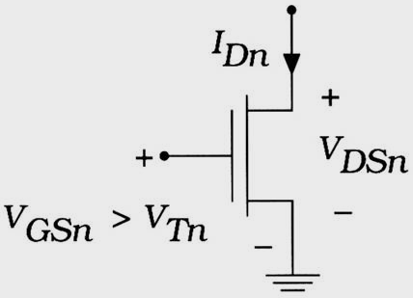
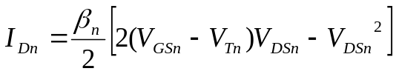
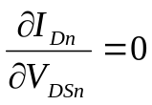
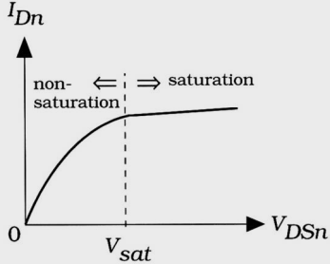
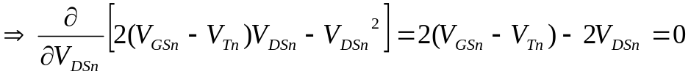

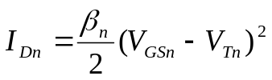
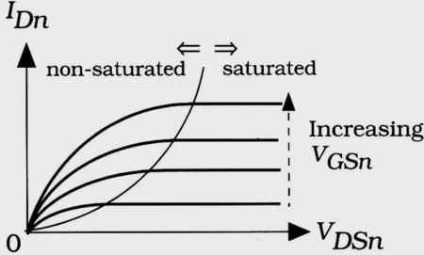
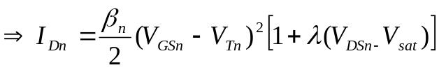
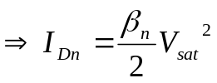
nMOS I – V Characteristics (2/2)
According Figure 6.13 (Model II, V_{GSn} > V_{Tn})
(6.29)
(active region current)
(6.30)
(6.31)
Figure 6.13 I - V characteristics as a function of V_{DSn}
(6.32)
(saturation voltage)
(6.33)
(saturation current)
(6.34)
Where λ (V⁻¹) is channel length modulation parameter
Figure 6.14 nFET family of curves
(6.35)

Slide 12
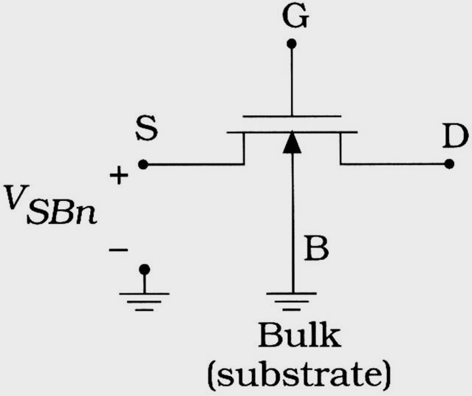



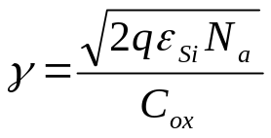
Body-bias Effect
Body-bias effects: occur when a voltage V_{SBn} exists between the source and bulk terminals
(6.45)
Where γ is the body-bias coefficient with units of V^{1/2}, and is the bulk Fermi potential term1
(6.46)
(zero body-bias threshold voltage)
Figure 6.15 Bulk electrode and body-bias voltage
(6.47)
Where q = 1.6 × 10⁻¹⁹ C, ε_{Si} = 11.8ε₀ is the permittivity of silicon, and Na si the acceptor doping in the p-type substrate

Slide 13
Outline
MOS Physics
nFET Current-Voltage Equations
The FET RC Model
pFET Characteristic
Modeling of Small MOSFETs

Slide 14
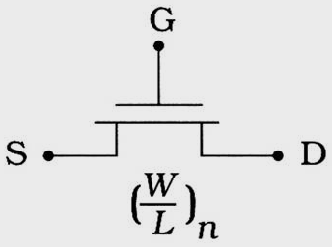
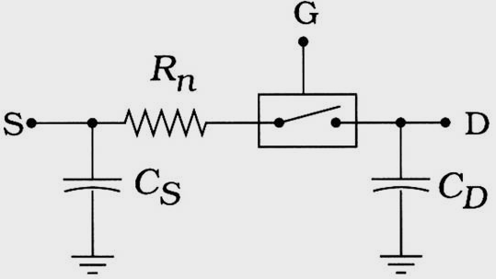
Non-linear and Linear
The difference between analysis and design
  Since non-linear I-V characteristics issue
  Analysis deals with studying a new network from the design, and designers are true problem solvers
Two approaches to dealing with the problem of messy transistor equations
  Let circuit specialists deal with the issues introduced by the non-linear devices
  Create a simplifies linear model since VLSI design is based on logic and digital architectures
(a) nFET symbol
(b) Linear model for nFET
Figure 6.19 RC model of an nFET

Slide 15

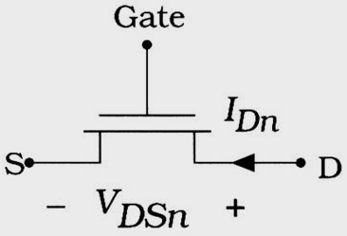



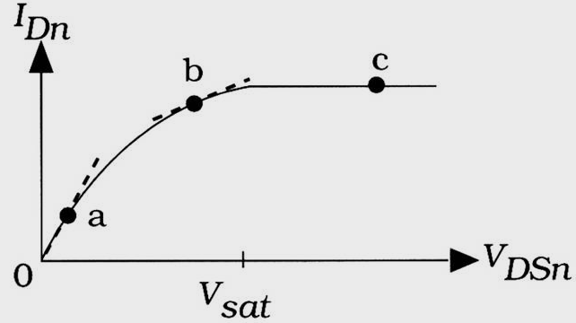





Drain-Source FET Resistance
In practical, FET are inherently non-linear
(6.64)
(drain-source resistance)
(6.65)
(at a point in Figure 6.20)
(6.66)
(6.67)
(at b point in Figure 6.20)
(6.68)
(at c point in Figure 6.20)
(6.69)
(6.70)
Figure 6.20 Determining the nFET resistance
(6.71)
(6.72)

Slide 16
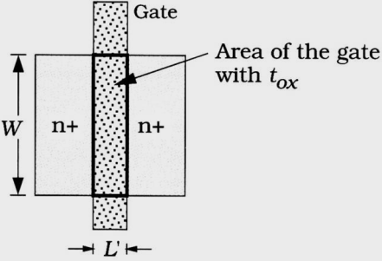
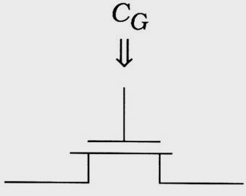


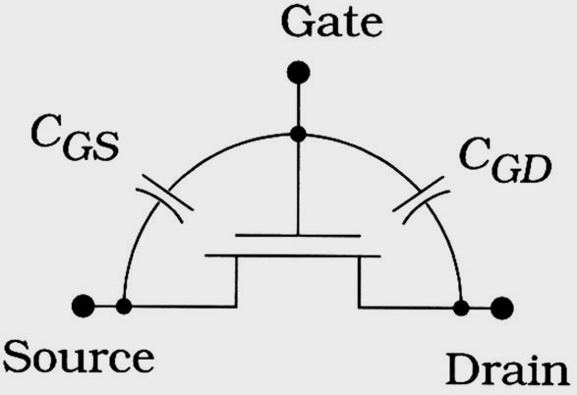
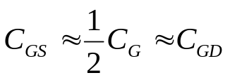
FET Capacitances
The maximum switching speed of a CMOS circuit is determined by the capacitances
When we have C = C(V), the capacitance is said to be non-linear
(6.76)
(6.77)
(a) Circuit perspective
(b) Physical origin
Figure 6.21 Gate capacitance in a FET
(6.78)
(ideal model)
Figure 6.22 Gate-source and gate-drain capacitance

Slide 17
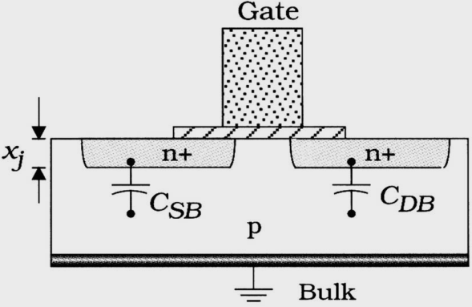

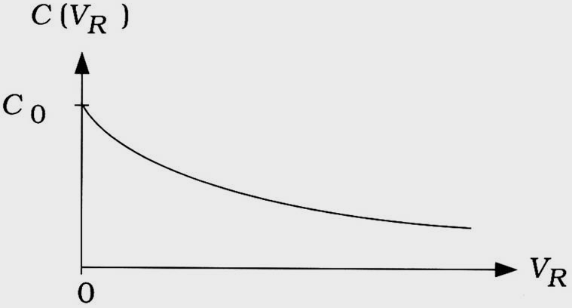
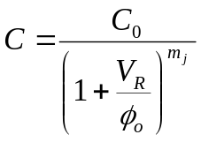
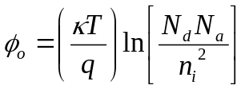
Junction Capacitance (1/2)
Semiconductor physics reveals that a pn junction automatically exhibits capacitance due to the opposite polarity charges involved is called junction or depletion capacitance
  Such that the total capacitance is (C_{SB} and C_{DB})
Two complications in applying this formula to the nFET
  First, this capacitance also varies with the voltage (C = C(V))
  Second in next slide
(6.82)
Where A_{pn} is the area of the junction in units of cm², and C_{j} is determined by the process, and varies with doping levels
Figure 6.23 Junction capacitance in MOSFET
(6.83)
Figure 6.24 Junction capacitance variation with reverse voltage
(6.84)
(built-in potential)

Slide 18
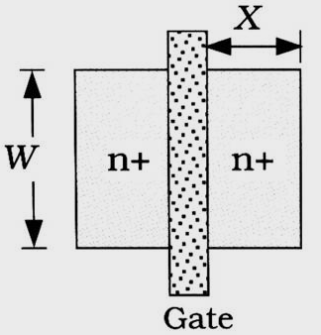





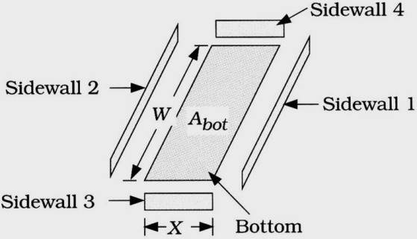



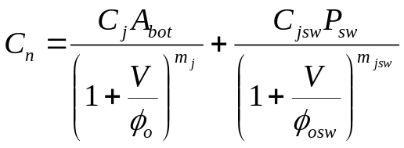
Junction Capacitance (2/2)
Second, we need to consider in calculating the pn junction capacitance is the geometry of the pn junctions
(6.85)
(6.86)
(1. bottom section)
(6.87)
(2. sidewall)
(a) Top view
(6.88)
(sidewall perimeter)
(6.89)
(6.90)
(sidewall capacitance per unit perimeter)
(6.91)
(including the overlap section)
(6.92)
(1 + 2)
(b) Geometry
(6.93)
(non-linear model)
Figure 6.25 Calculation of the FET junction capacitance

Slide 19
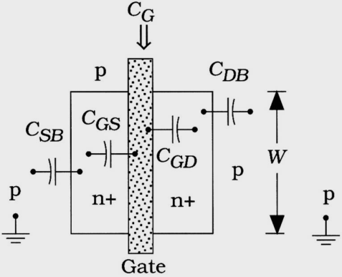




Construction of the Model
Parasitic resistance and capacitance of MOS
It is important to note that the resistance R_{n} is inversely proportional to the aspect ratio (W/L)_{n}, while the capacitances increase with the channel width W
(6.94)
Figure 6.26 Physical visualization of FET capacitances
(a) nFET
(b) Linear model for nFET
Figure 6.25 Calculation of the FET junction capacitance

Slide 20
Outline
MOS Physics
nFET Current-Voltage Equations
The FET RC Model
pFET Characteristic
Modeling of Small MOSFETs
Reference for Further Reading
Problems

Slide 21






pFET Characteristic (1/4)
nFET translates to pFET
  Change all n-type regions to p-type regions
  Change all p-type regions to n-type regions
Note, both the direction of the electric fields and the polarities of the charges will be opposite according equation (6.101)
n-well is tied to the positive power supply
Figure 6.29 Transforming an nFET to a pFET
(6.101)
(a) Side view
(b) Top view
Figure 6.30 Structural detail of a pFET

Slide 22






pFET Characteristic (2/4)
V_{SGp} determines whether the gate is sufficiently negative with respect to the source to create a layer of holes under the gate oxide and thus establish a positive hole charge density of Q_{h} C/cm²
(a) Symbol
(6.102)
(6.103)
(6.104)
(b) Structure
Figure 6.31 Current and voltages in a pFET

Slide 23










pFET Characteristic (3/4)
(6.105)
(6.106)
(a) Cutoff
(b) Active bias
(6.107)
Figure 6.32 Conduction modes of a pFET
(6.108)
(6.109)
Figure 6.33 Gate-controlled pFET current-voltage characteristics

Slide 24





pFET Characteristic (4/4)
(6.110)
(6.111)
(6.112)
Figure 6.34 pFET I – V family of curves

Slide 25
Outline
MOS Physics
nFET Current-Voltage Equations
The FET RC Model
pFET Characteristic
Modeling of Small MOSFETs

Slide 26










Scaling Theory (1/2)
(6.118)
(6.123)
(6.119)
(6.124)
(6.120)
(6.125)
(6.121)
(6.126)
(6.122)
(6.127)

Slide 27






Scaling Theory (2/2)
(6.128)
(6.129)
(6.130)
(6.131)
(6.132)
(6.133)

